Slide 1
Lecture 3
Analyzing Risk: An Introduction to Modeling Uncertain Inputs

Slide 2
Module 2 Study Guide and Deliverables
Topics: | Lectures 3: Analyzing Risk: An Introduction to Modeling Uncertain Inputs Lectures 4: Analyzing Risk: incorporating Uncertainty into the Decisions of the Enterprise
Readings: | Lectures 3 and 4 online content
Discussions: | Module 2 Discussion
Assignments: | Assignment 1: Individual Assignment covering Lecture 1 and Lecture 2.
Assessments: | Quiz 1

Slide 3
Learning Objectives
After you complete this lecture, you will be familiar with the following concepts:
Commonly used discrete and continuous probability distributions
Relationships among probability distributions
Probability density function and probability mass function
Cumulative distribution function
R functions for commonly used probability distributions

Slide 4
Probability and Uncertainty
We start this lecture by reviewing probability concepts and its relation to uncertainty.
Probability provides a scale for the likelihood of an event.
Probability 1 means the event is certain.
Probability 0 means it will not happen.
A probability of 0.8 means that over many identical situations, the event will happen 80% of the time.
The uncertain cells in our spreadsheets do not contain random numbers but probability distributions. A probability distribution literally distributes the probability that something happens among a collection of possible outcomes.
As discussed in the previous modules, we use probability distributions to model uncertain situations. Our goal in this lecture is to get familiar with common probability distributions and learn which distribution to use to model a particular uncertain input in our model.
A probability distribution is either discrete or continuous. A discrete probability distribution is used when the uncertain quantity can take only discrete values; e.g., the demand for a particular product during next month. This can only take discrete values such as 5, 10, 15… A continuous probability distribution is used when the uncertain quantity can take all values in a range; e.g., time to finish an activity. This could go from 0 to infinity and any value is possible.

Slide 5
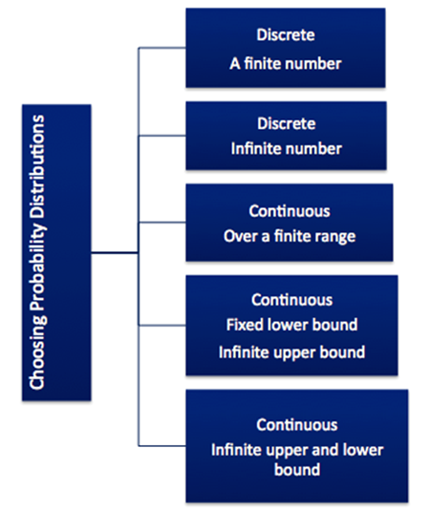
Classification of Probability Distributions Based on Possible Outcomes
When trying to model an uncertain situation using a probability distribution, the first question is: What is the collection of possible outcomes? Therefore, in this lecture we will classify probability distributions according to the possible values that the outcomes that they represent may take. Under each category, there are several probability distributions. Our goal in this lecture is to learn the physical basis of the distributions; i.e, what distribution best represents the situation we are trying to model.
Figure 3.1

Slide 6
Possible Outcomes – Discrete, and a finite number
Examples of situations where we have discrete outcomes and there are only a finite number of these outcomes are:
Number of workers absent out of 70 in a shift
Number of defective parts in a lot of 100
R can generate random variables from several such distributions. We will cover the binomial and the discrete uniform distribution.

Slide 7
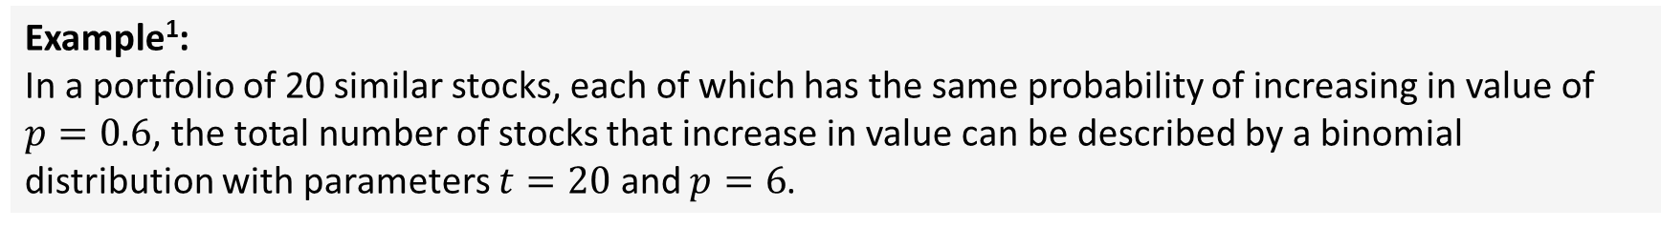
Possible Outcomes – Discrete, and a finite number
Binomial Distribution: Models the number of successes in $t$* trials, when the trials are independent with success probability $p$. $t$ must be a natural number, and $p$ must be between 0 and 1.
Example¹:
In a portfolio of 20 similar stocks, each of which has the same probability of increasing in value of $p=0.6$, the total number of stocks that increase in value can be described by a binomial distribution with parameters $t=20$ and $p=6$.
To generate random variables from a binomial distribution, we can use the rbinom function. rbinom takes three arguments: the size of the vector you want to generate, the number of trials for the binomial experiment being run, and the probability of success for each trial. For example, rbinom(15,100,.6) would generate 15 binomially distributed random variables, where each experiment has 100 trials and a 60% probability of success.
More often, you’ll see the number of trials referred to as $n$. Since R uses $n$ as the size of the vector to be generated, we avoid confusion here by calling this $t$.

Slide 8
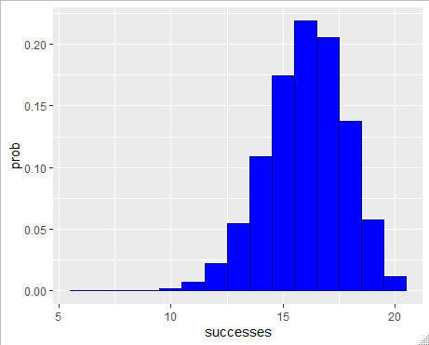
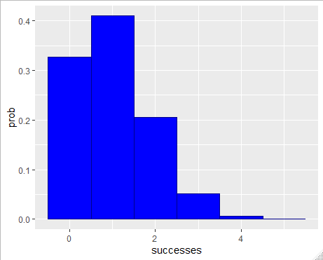
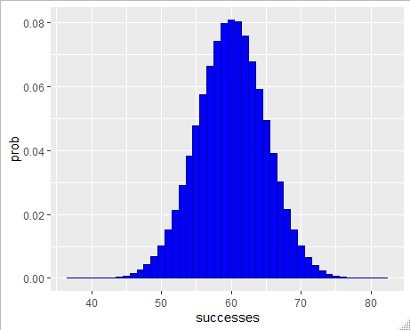






Possible Outcomes – Discrete, and a finite number
Figures 3.22-3.4 all show histograms for different binomial random variables. To get a good idea of what each distribution looks like, we set the number of trials to 1,000,000.
Figure 3.2: a$\sim bin(20,.8)$
Figure 3.3: b$\sim bin(5,.2)$
Figure 3.4: c$\sim bin(100,.6)$

Slide 9
Possible Outcomes – Discrete, and a finite number
Discrete Uniform: Models complete uncertainty, since all outcomes are equally likely. This takes two parameters: the minimum possible outcome (min) and the maximum possible outcome (max). Max must be greater than min.
Example: The demand for a particular shirt is expected to vary between $min=50$ and $max=150$. Each number between the quantities 50 and 150 is equally likely.
To generate random variables from a discrete uniform distribution, we can slightly modify the uniform distribution. (The uniform distribution is covered later in this lecture.) We start with a uniform distribution with the same minimum, but add one to the maximum. We then round the number down. The result will have a discrete uniform distribution. The function can be seen in Figure 3.5, and a histogram of the results of one such random variable (with 1,000,000 numbers generated) is shown in Figure 3.6.

Slide 10

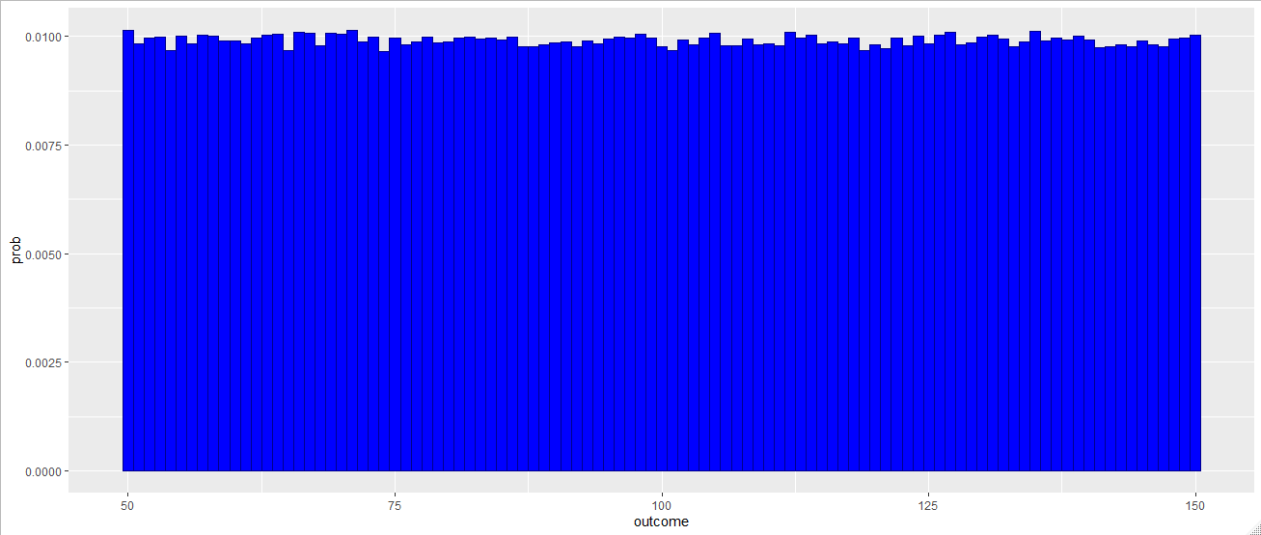


Possible Outcomes – Discrete, and a finite number
Figure 3.5
Figure 3.6: a$\sim dunif(50,150)$

Slide 11
Possible Outcomes – Discrete, and infinite number
In some situations, we know the outcome will be an integer, but there are nonetheless infinite possible outcomes (the result is always some finite number, but it can be arbitrarily large). Examples include:
Annual demand for a product
Number of accidents during the year
R can generate numbers from these distributions too. We will cover geometric, Poisson, and negative binomial distributions.

Slide 12
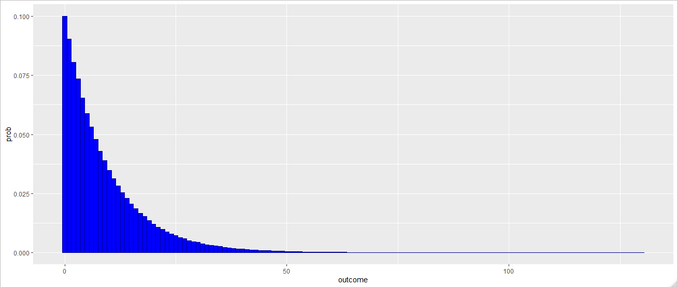
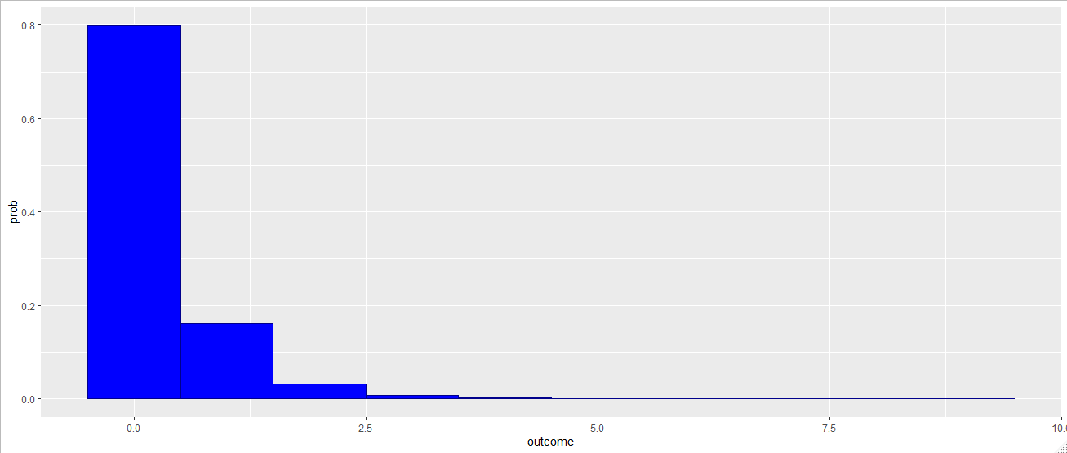




Possible Outcomes – Discrete, and infinite number
Geometric Distribution: Models the number of failures before the first success in a sequence of independent trials with probability $p$ of success on each trial. The only parameter for a geometric distribution is $p$. $p$ must be between 0 and 1.
Example:² An R&D division of a company may invest in several projects that fail before investing in a project that succeeds. If each project has a probability of success $p$, the number of projects that fail before a successful project occurs is a geometric random variable with parameter $p$.
For this, we can use the rgeom function, native to R. Figures 3.7 and 3.8 show histograms from randomly generated geometric variables with $p=0.1$ and $p=0.8$.
Figure 3.7: $a\sim geom(.1)$
Figure 3.8: $a\sim geom(.1)$

Slide 13
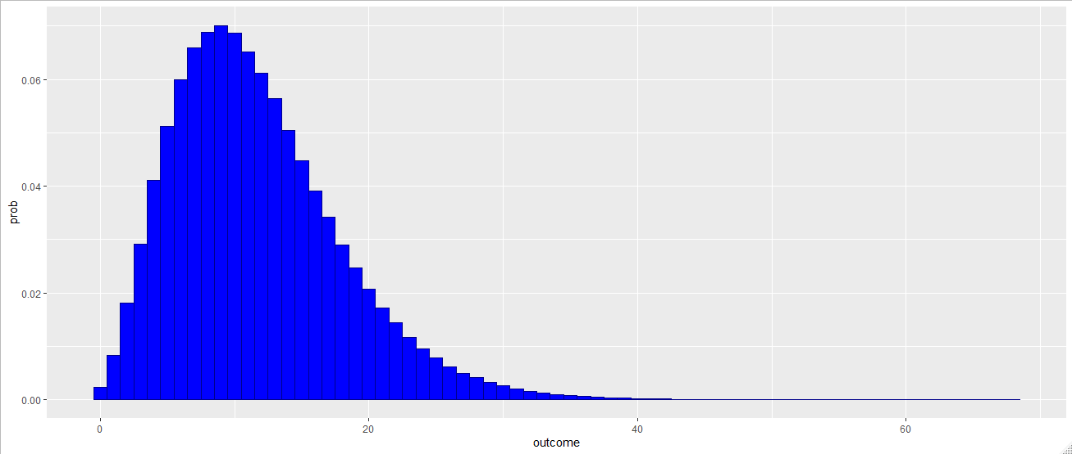


Possible Outcomes – Discrete, and infinite number
Negative Binomial Distribution: Models the number of failures before the $s^{th}$ success in a sequence of independent trials with probability $p$ of success on each trial. $s$ and $p$ are the only parameters. $s$ must be a natural number, and $0<p<1$.
Example: If each project in an R&D department has the same chance of success, the number of projects that fail in the R&D division before experiencing three successful projects is a negative binomial random variable.
For this, we can use the rnbinom function, native to R. Figure 3.9 shows a histogram from a randomly generated negative binomial variables with $s=5$ and $p=0.3$.
Individual Exercise: How could you set the parameters of a negative binomial distribution such that the result would also be a geometric distribution?
Figure 3.9: $a\sim negbin(5,.3)$

Slide 14
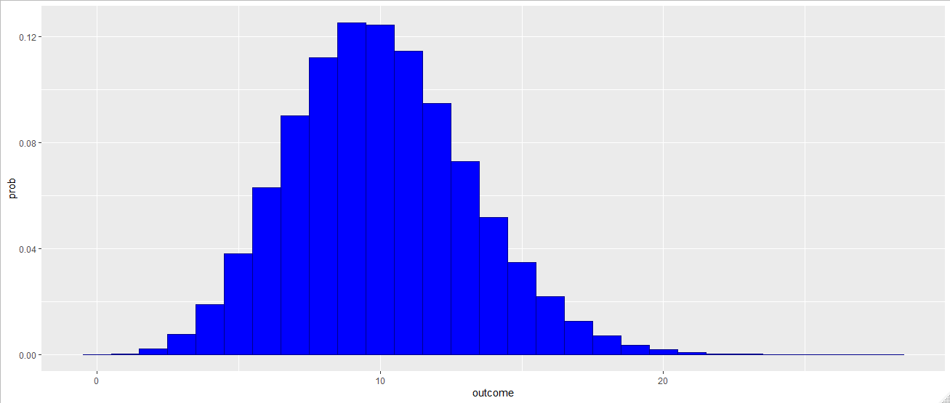
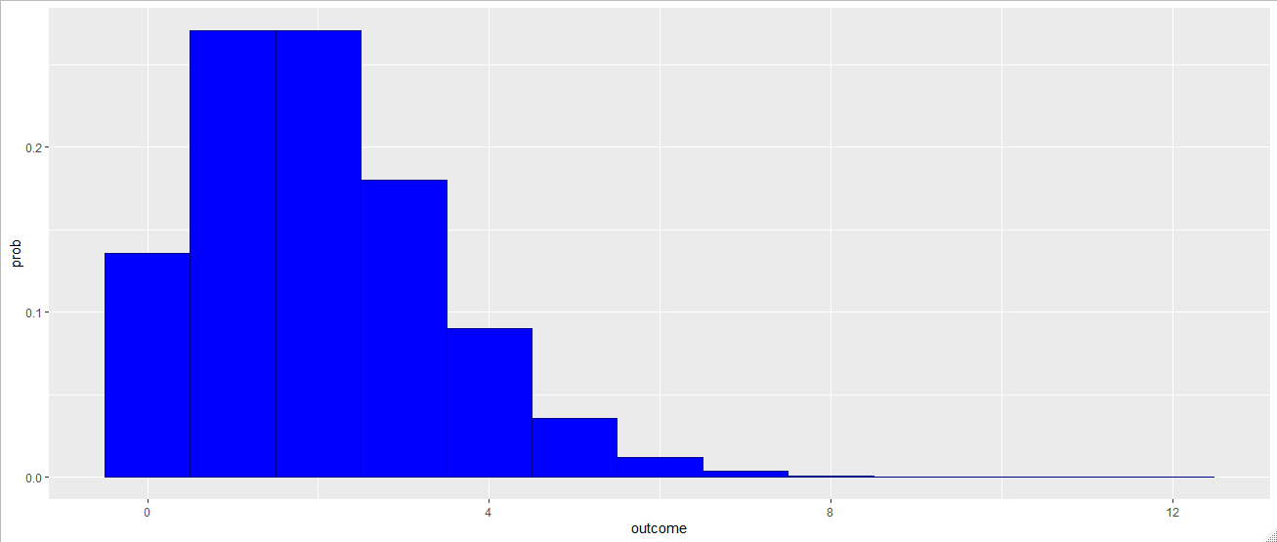


Possible Outcomes – Discrete, and infinite number
Poisson Distribution: Models the number of independent events that occur in a fixed period of time. It’s fully parametrized by $m$, the mean (or expected) number of times the event will occur. $m$ must be greater than 0.
Example: If, on average, 10 customers arrive at a store during one hour, then the number of customers arriving at the store in an hour can be modeled as a Poisson random variable with $m=10$.
For this, we can use the rpois function, native to R. Figures 3.10 and 3.11 show Poisson distributions with $m=10$ and $m=2$.
Figure 3.9: $a\sim Pois(10)$
Figure 3.10: b$\sim Pois(2)$

Slide 15
Possible Outcomes – continuous over a finite range
Examples of situations where we have continuous outcomes over a finite range are:
Number of productive hours during a day
Interest rate change next month
Of distributions that fit this description, we will cover uniform, triangular, beta, and pert distributions.
For continuous distributions, I will use the geom_density function rather than the geom_histogram function, since geom_density better captures the notion of a continuous distribution.

Slide 16
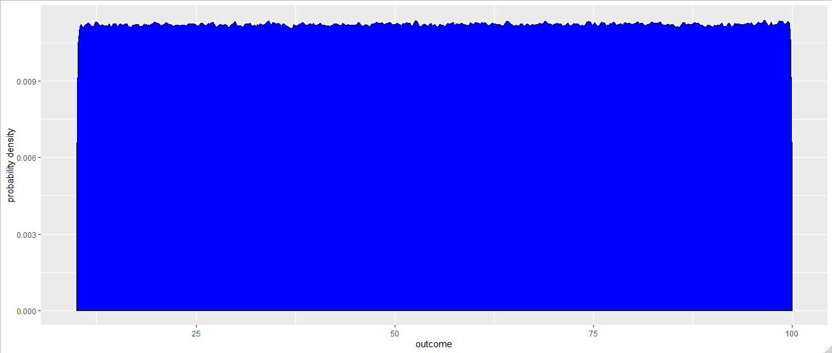

Possible Outcomes – continuous over a finite range
Uniform: Models complete uncertainty, since all outcomes are equally likely. This takes two parameters: the minimum possible outcome (min) and the maximum possible outcome (max). Min must be less than max.
Example: A commercial pool supplier store sells chlorine by the ton. They anticipate minimum demand of 10 tons and a maximum demand of 100 tons, with every intermediate amount equally likely.
To model a uniform distribution, we can use the runif function in R. (Here the adjust argument is used to mitigate R’s density algorithm’s inaccuracy at either end of the interval. This causes the random fluctuation over the rest of the interval. The result of the above example is displayed in Figure 3.11.
Figure 3.11: a$\sim Unif(10,100)$

Slide 17
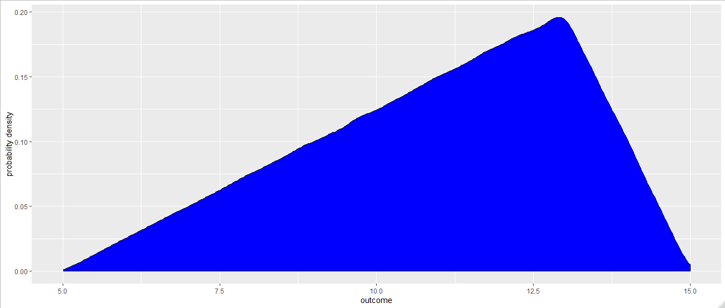
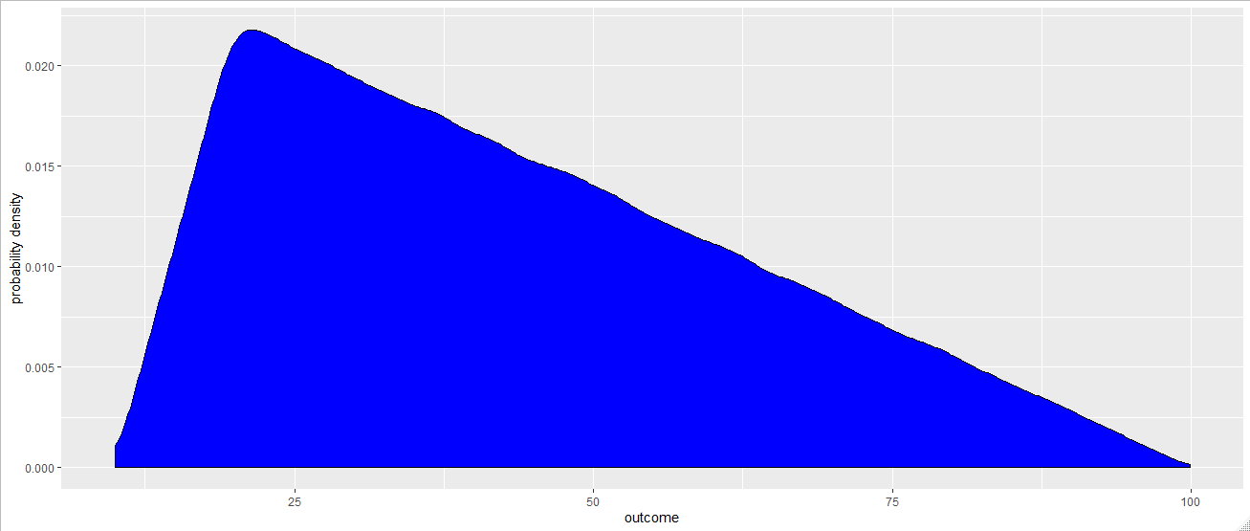




Possible Outcomes – continuous over a finite range
Triangular Distribution: Models a process when only the minimum, most likely and maximum values of the distribution are known. The parameters are min, ml, and max, with $min<ml<max$.
Example: If we are given the minimum, most likely and maximum inflation rate we will have this year, then the random variable inflation rate can be modeled with a triangular distribution.
As in lecture 2, since R has no triangular distribution in its base package, we use our own code to make one. We use the same syntax as before. Figures 3.12 and 3.13 show different triangular distributions.
Figure 3.12: $a\sim Tri(5,13,15)$
Figure 3.13: $b\sim Tri(10,30,100)$

Slide 18
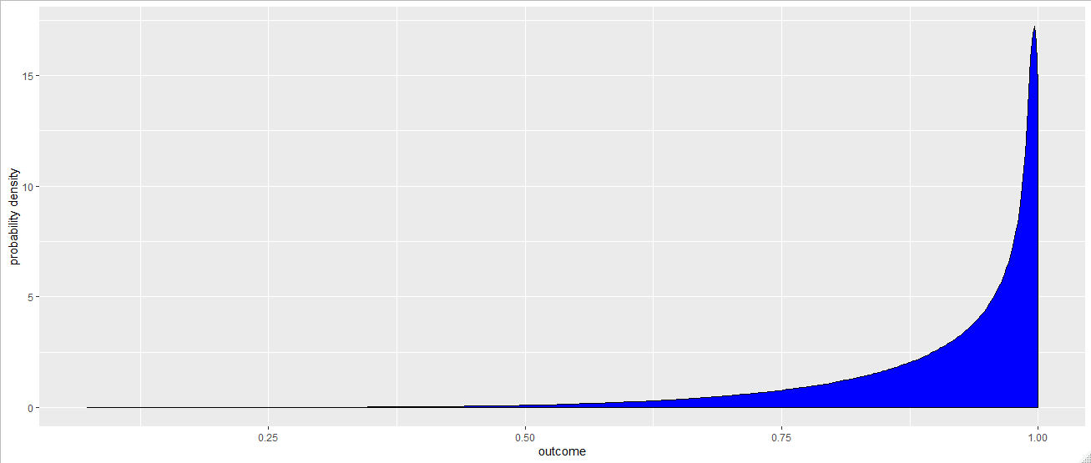
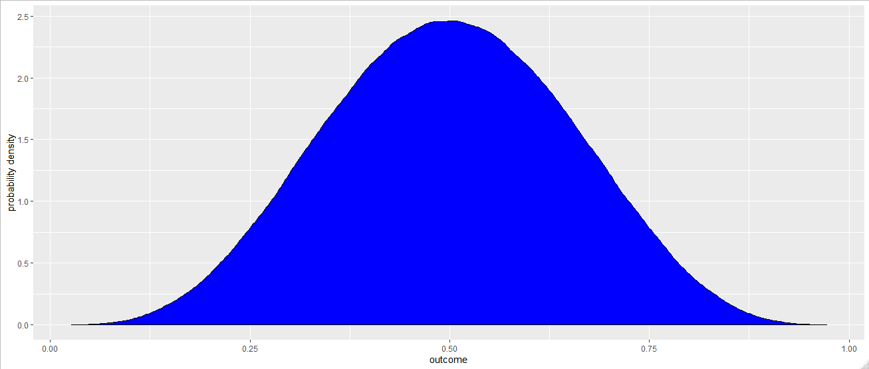
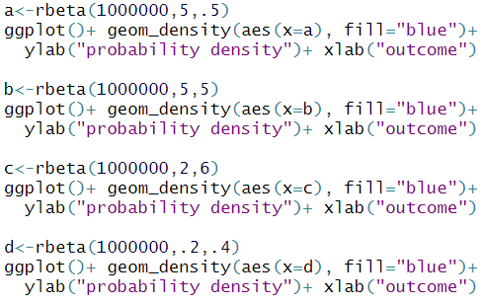
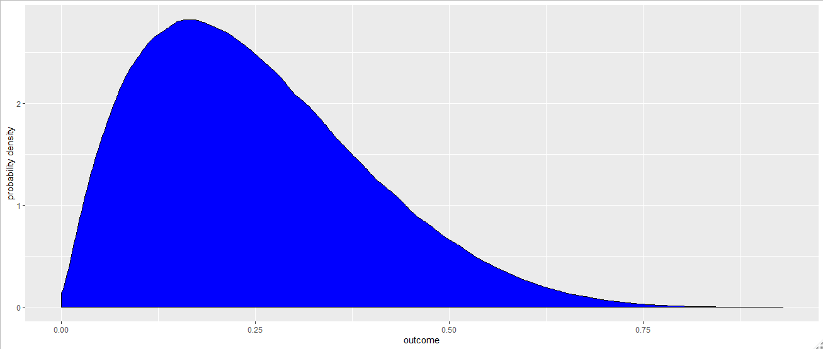
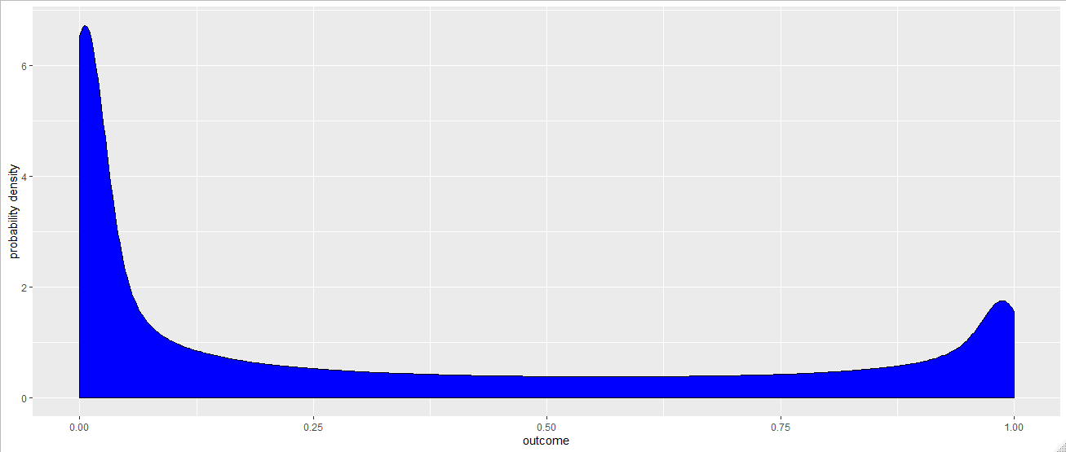
Possible Outcomes – continuous over a finite range
Beta Distribution: An extremely flexible distribution used to model bounded (fixed upper and lower limits) random variables in the absence of data. It has two parameters: $α$ and $β$, (alpha and beta) both of which must be greater than 0.
Example: Proportion of defective items in a shipment
A Beta distributed random variable will only take on values between 0 and 1, but the shape can change drastically depending on $α$ and $β$. The rbeta function can generate beta rv’s. Figure 3.14 contains just some examples.
a
b
c
d
Figure 3.14

Slide 19
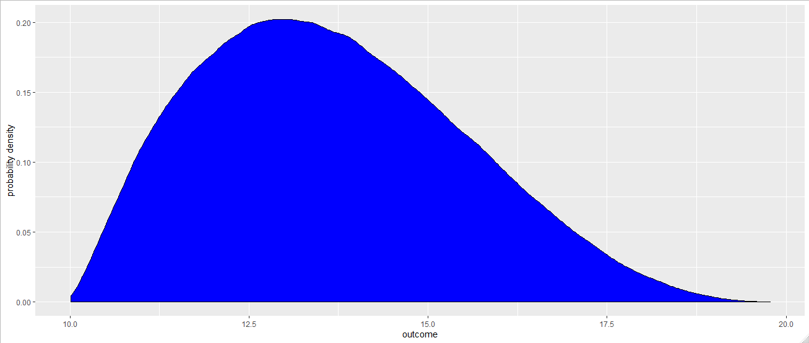


Possible Outcomes – continuous over a finite range
Pert Distribution: Used to model the activity times in project management problems and defined by three point estimates, minimum value, most likely value and maximum value to complete an activity. Like the triangular distribution, $min<ml<max.$
Example: Time to complete a task in a PERT network.
Like the triangular distribution, the Pert distribution isn’t in R’s base package. It can be developed as a transform of the Beta distribution. The code to do so is in Figure 3.15. An example of a pert distribution is in Figure 3.16.
Figure 3.15
Figure 3.16

Slide 20
Possible Outcomes – Continuous with fixed lower bound and infinite upper bound
Examples of situations where we have continuous outcomes with fixed lower bound and infinite upper bound are (there is always some finite upper bound, but it may be quite large and unknown):
Total time to complete a work order
Time to failure of a machine or component
We will cover the Exponential, Gamma, and Lognormal distributions.

Slide 21
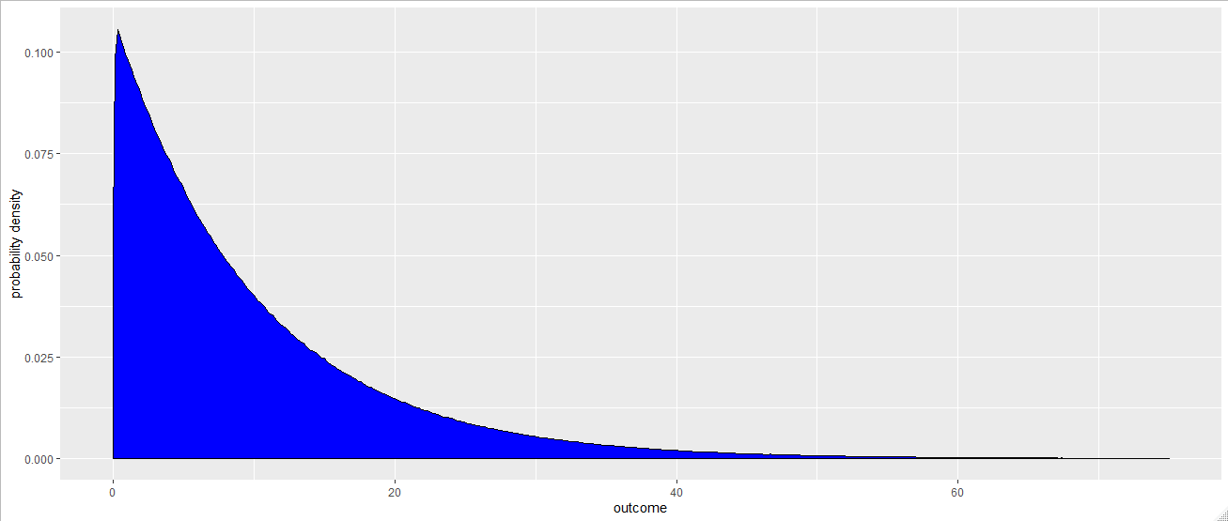

Possible Outcomes – Continuous with fixed lower bound and infinite upper bound
Exponential Distribution: Models the time between independent events. It takes one parameter, which is the mean (expected value) of the distribution. It is sometimes parameterized as the multiplicative inverse of the mean (1/mean): this is the frequency of the distribution.
Example: The time to failure for a system that has constant failure rate over time is represented as an exponential random variable.
R generates random variables using the rexp function. It is parameterized by the frequency (in R, the “rate”) rather than the mean. Figure 3.17 contains an example of an exponential distribution with mean 10.
Figure 3.17

Slide 22
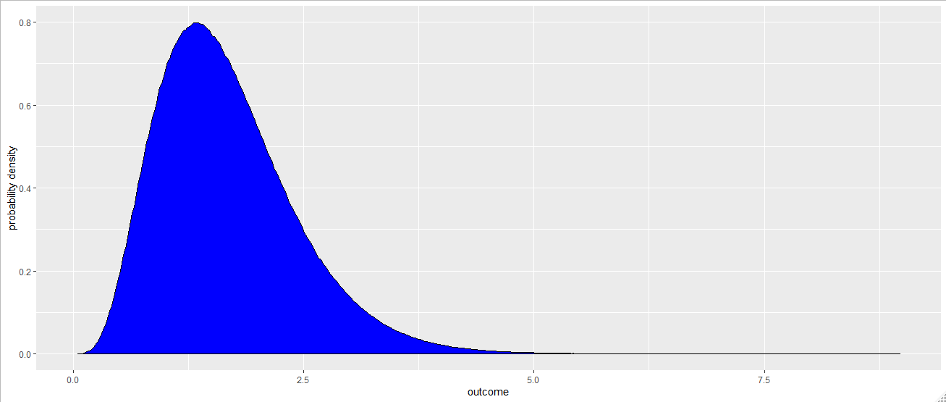

Possible Outcomes – Continuous with fixed lower bound and infinite upper bound
Gamma Distribution: An extremely flexible distribution used to model nonnegative random variables. The gamma distribution has shape parameters: $α$ and scale parameter $β$, with $α, β>0.$
Example: Time to complete some task, e.g., customer service or machine repair.
You can generate gamma distributed random variables using the rgamma function. Figure 3.18 contains an example of a gamma distribution with $α=5,β=3$.
Individual Exercise: Can you find discrete analogs for the exponential and gamma distributions?
Figure 3.18

Slide 23
Possible Outcomes – Continuous with fixed lower bound and infinite upper bound
Lognormal Distribution: Models the distribution of a process that can be thought of as the product of a number of component processes. Lognormal distribution is widely used for modeling the service times such as appointments. Note that the numbers generated by using lognormal distribution is always positive. It is parameterized by its mean (m) and standard deviation (s), both of which must be greater than 0.
Example: The rate of return on an investment, when interest is compounded, is the product of the returns for a number of periods. Therefore, the rate of return can be modeled as a lognormal random variable with a given mean and standard deviation
R parameterizes lognormal distributions by the mean and standard deviation of the underlying normal distribution rather than the lognormal distribution itself. This relationship will be described in further detail in class. In order to parameterize the lognormal distribution the way we desire, we write our own function, whose code is provided in Figure 3.19:
Figure 3.19

Slide 24
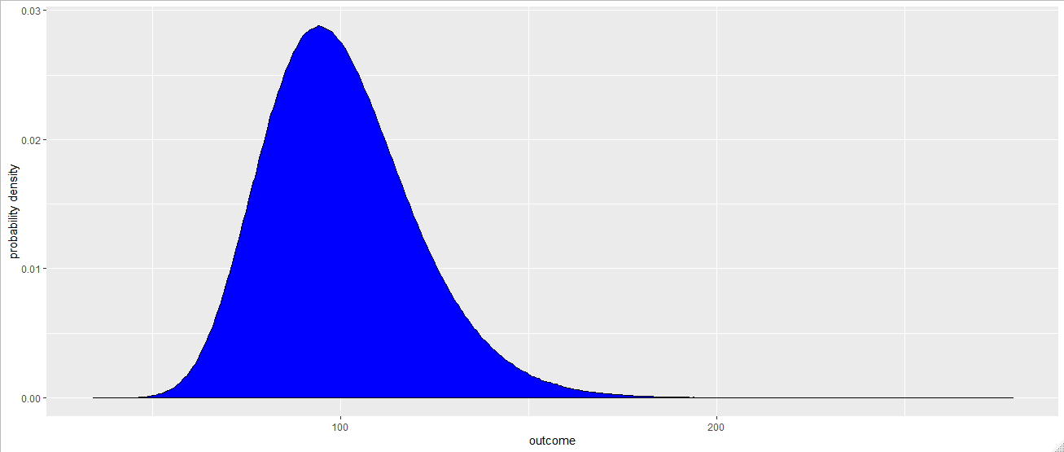

Possible Outcomes – Continuous with fixed lower bound and infinite upper bound
Figure 3.20: A lognormal distribution with mean 100 and standard deviation 20

Slide 25
Possible outcomes – Continuous with infinite upper and lower bounds
Examples of situations where we have continuous outcomes with infinite upper and lower bounds are (there are always some finite bounds, but they may be quite large and unknown):
Deviation of demand from forecast
Deviation of an employee's performance from the average performance of all employees
We will cover the normal and Student distributions.

Slide 26
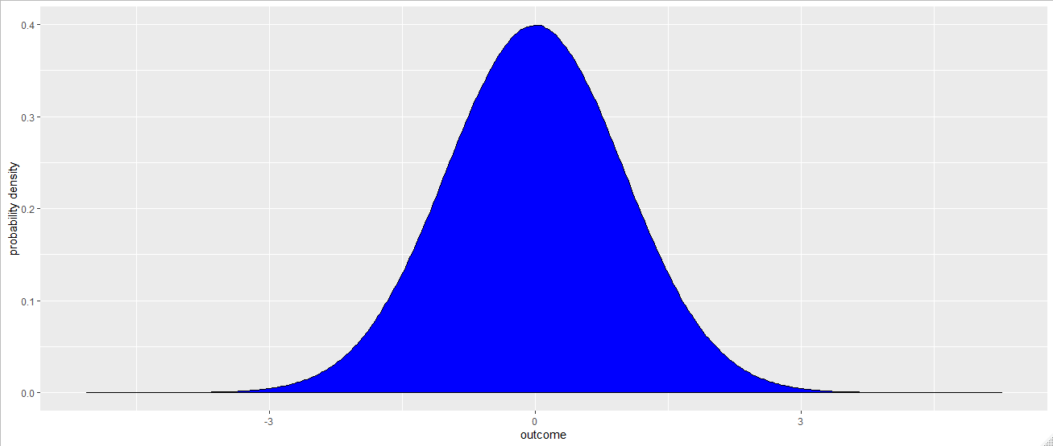

Possible outcomes – Continuous with infinite upper and lower bounds
Normal Distribution: Models errors of various types and quantities that are the sum of a large number of other quantities. Normal distributions are parameterized by their mean and standard deviation.
Example: In human resource management, employee performance is often represented with a normal distribution.
As we’ve already seen, R generates random variables with normal distribution using the rnorm function. Figure 3.21 shows an example of the standard normal distribution, which has mean 0 and standard deviation 1.
Figure 3.21

Slide 27
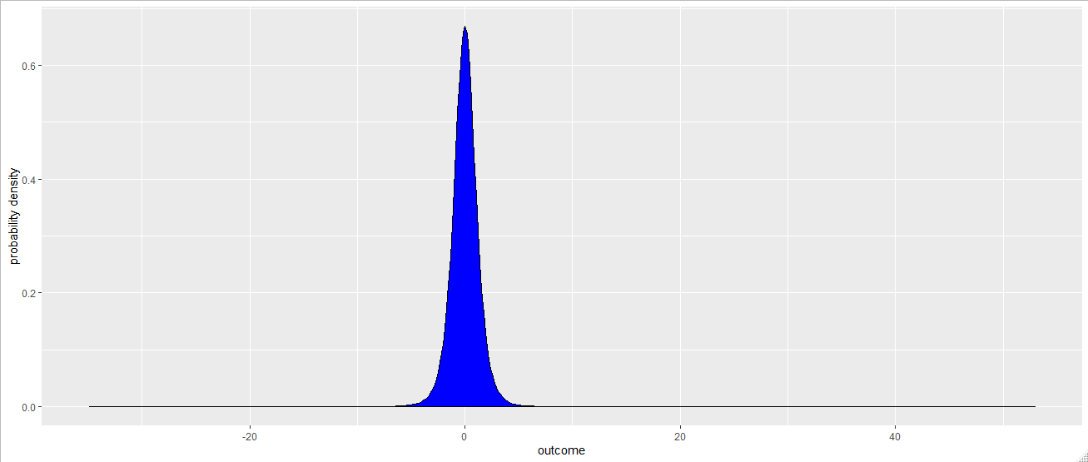
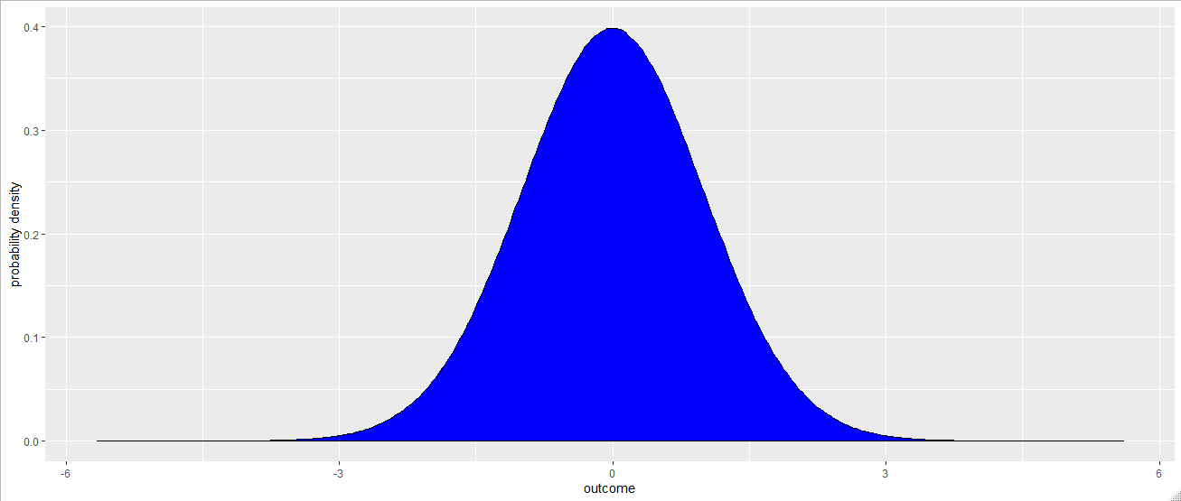


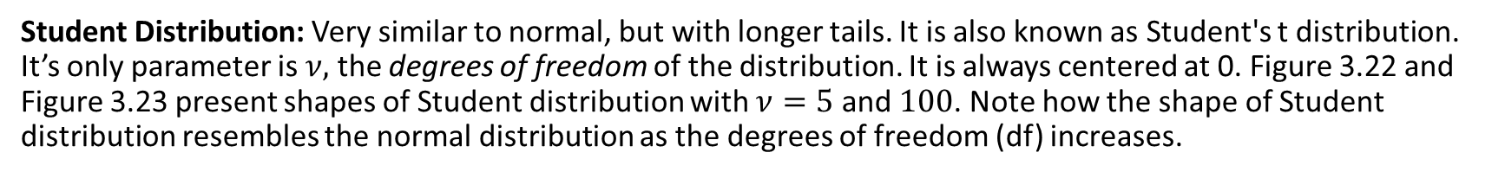
Possible outcomes – Continuous with infinite upper and lower bounds
Student Distribution: Very similar to normal, but with longer tails. It is also known as Student's t distribution. It’s only parameter is $ν,$ the degrees of freedom of the distribution. It is always centered at 0. Figure 3.22 and Figure 3.23 present shapes of Student distribution with $ν=5$ and $100$. Note how the shape of Student distribution resembles the normal distribution as the degrees of freedom (df) increases.
Figure 3.22
Figure 3.23

Slide 28
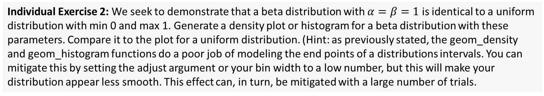
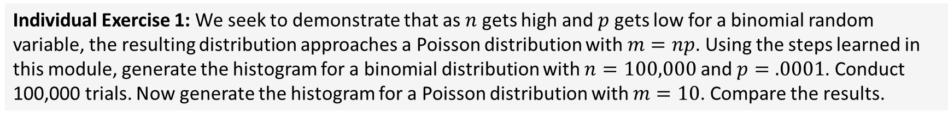
Relationships Among Distributions
In this part of the lecture, we will illustrate how different distributions relate to each other.
Binomial and Poisson
Individual Exercise 1: We seek to demonstrate that as $n$ gets high and $p$ gets low for a binomial random variable, the resulting distribution approaches a Poisson distribution with $m=np$. Using the steps learned in this module, generate the histogram for a binomial distribution with $n=100,000$ and $p=.0001$. Conduct 100,000 trials. Now generate the histogram for a Poisson distribution with $m=10$. Compare the results.
Beta and Uniform
Individual Exercise 2: We seek to demonstrate that a beta distribution with $α=β=1$ is identical to a uniform distribution with min 0 and max 1. Generate a density plot or histogram for a beta distribution with these parameters. Compare it to the plot for a uniform distribution. (Hint: as previously stated, the geom_density and geom_histogram functions do a poor job of modeling the end points of a distributions intervals. You can mitigate this by setting the adjust argument or your bin width to a low number, but this will make your distribution appear less smooth. This effect can, in turn, be mitigated with a large number of trials.

Slide 29
Relationships Among Distributions
In this part of the lecture, we will illustrate how different distributions relate to each other.
Gamma and Exponential.
Individual Exercise 3: We seek to demonstrate that, when the shape parameter $α=1$ in a gamma distribution, the result is an exponential distribution with mean equal to the scale parameter. Create histograms or density plots for both distributions to test this theory.
Student distribution approaches the normal distribution as the degrees of freedom parameter increases.
Individual Exercise 4: Create histograms or density plots for student distributions with increasing degrees of freedom to test this theory.
Exponential and Poisson
We will discuss this further in class.
Lognormal and Normal
If you take the logarithm of a lognormal distribution, the result will be normally distributed. We will discuss this relationship further in class.

Slide 30
Understanding Distributions
The probability density function (pdf) (for continuous outcomes) or probability mass function (pmf) (for discrete outcomes) gives the probability of specific values. The mass function allow us to answer the questions of the type: What is the probability that the number of customers will be exactly 4? In the continuous case, this relationship is more complicated, since the probability of hitting any outcome exactly is held to be 0.
The cumulative distribution function (cdf) gives the probability of being less than or equal to a value. With a cdf, for instance, we can find the probability that interest rate will be ≤ 8.3%. We can also use the cdf to determine the likelihood that an interest rate falls between two values, by taking the difference of two cdfs.
It is important to note that so far in this module, we have created pdfs and pmfs. However, it is not difficult to obtain a cdf.
In Figures 3.24 and 3.25, you can see two different aesthetic approaches to creating a cdf for a standard normal distribution, using the stat_ecdf function from ggplot2. Use whichever you find easier or more visually appealing.

Slide 31
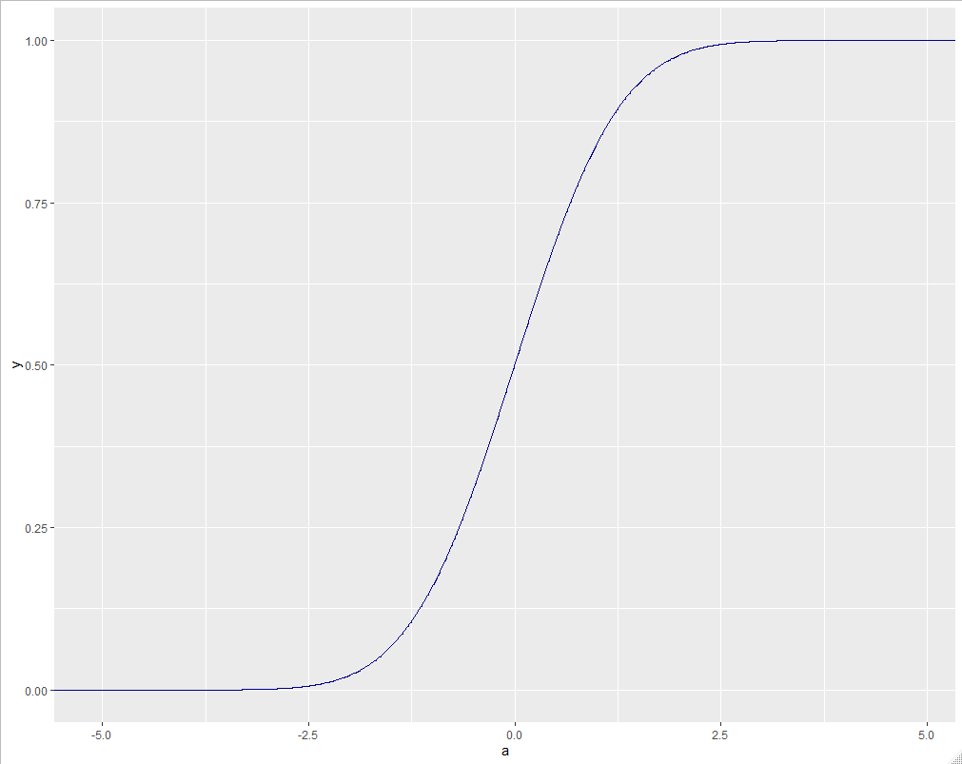
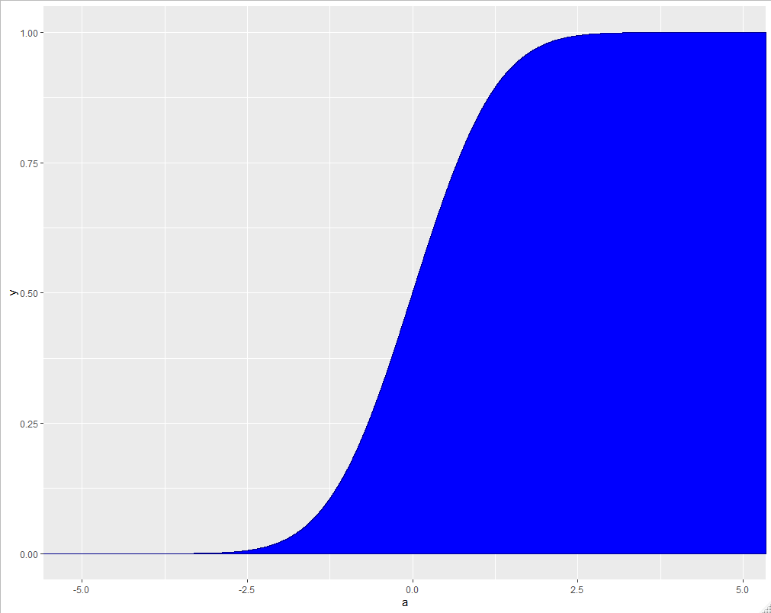

Understanding Distributions
Figure 3.24
Figure 3.25

Slide 32
Summary of Distributions
Distribution | R Function to randomly generate | Discrete or Continuous? | Bounded?
Beta | rbeta (n,alpha, beta) | Continuous | Yes
Binomial | rbinom(n,trials, probability) | Discrete | Yes
Discrete Uniform* | rdunif(n,min,max) | Discrete | Yes
Exponential | rexp(n,mean) | Continuous | Below
Gamma | rgamma(n, alpha, beta) | Continuous | Below
Geometric | rgeom(n,probability) | Discrete | Below
Lognormal* | rlnorm2 (n,mean, standard deviation) | Continuous | Below
Negative Binomial | rnbinom(n, successes, probability) | Discrete | Below
Normal | rnorm (n, mean, standard deviation) | Continuous | No
Pert* | rpert(n, min, most likely, max) | Continuous | Yes
Poisson | rpois (n, mean) | Discrete | Below
Student t | rt(n, degrees of freedom) | Continuous | No
Triangular* | rtri(n,min, most likely, max) | Continuous | Yes
Uniform | runif (n, min, max) | Continuous | Yes
*function user defined

Slide 33
Lecture 3 Footnotes
¹ Camm et al., Essentials of Business Analytics, 2015, Cengage Learning, pp. 548. ² Camm et al., Essentials of Business Analytics, 2015, Cengage Learning, pp. 548.

Slide 34
Lecture 3 References
Camm et al., Essentials of Business Analytics, 2015, Cengage Learning, pp. 548.
Law, A. M. and W. D. Kelton. Simulation Modeling and Analysis, Third edition, Chapter 6, pp. 299-318. (Note: A good reference book for the concepts discussed in this module)

Slide 35
Lecture 3 Summary Questions
What is the basis of categorizing probability distributions as “discrete” or “continuous”?
In representing an uncertain variable in a simulation study, how do we choose among different probability distributions?
Give examples to continuous and discrete probability distributions.
Discuss the following statements:
If we know only the minimum, maximum, and most likely values of a process, then we can use the triangular distribution to model this process.
If we know only the mean and standard deviation of a process, then normal distribution can be used to model this process.
Pert distribution is particularly useful when modeling project activity times.
What is the difference between a “probability density function” and a “cumulative distribution function”?

